Slide 1
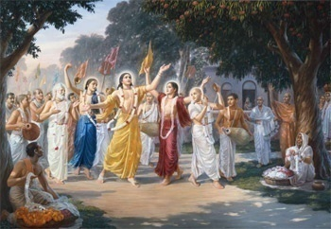
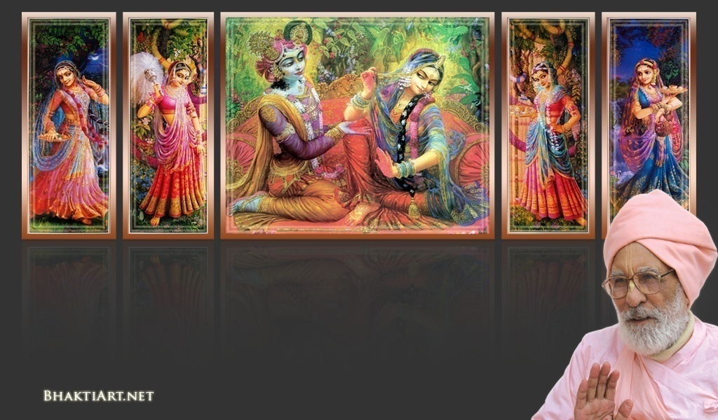
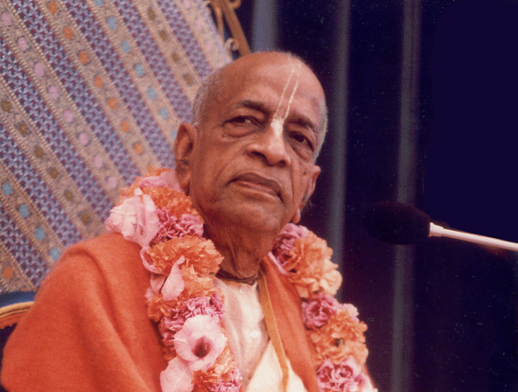
Sri Krsna Caitanya Prabhu Nityananda
Sri Advaita Gadadara Srivasadi
Gaura Bhakta Vrinda
NC-16-P02
0310
Jul 18, 2014
Hare Krsna Hare Krsna
Krsna Krsna Hare Hare
Hare Rama Hare Rama
Rama Rama Hare Hare
Gokul Bhajan & Vedic Studies
North Carolina, USA
Notes:
Om Ajnana timirandhasya, jnananjana salakaya
Caksur unmimiltam yena, tasmai sri gurave namah
Namah om vishnu padaya, radhikayah priyatmane
Sri-srimad bhaktivedanta, narayana iti namine
Sri krishna lila kathane sudaksham
Audarya-madhurya gunais ca yuktam
Varam varenyam purusham mahantam
Narayanam tvam sirasa namami
He krishna karuna sindho, dina bandho jagat pate
Gopesha gopika kanta, radha kanta namo ‘stu te
tapta kancana gaurangi, radhe vrindavaneshvari
vrsabhanu sute devi, pranamami hari priye
bhajami radham aravinda netram
smarami radham madhurasmi-tasyam
vadami radham karuna bharardram
tato mam anyasti gatir na kapi
bhaktya vihina aparadha lakshai
ksiptas ca kamadi taranga madhye
krpamayi tvam saranam prapanna
vrinde numas te caranara vindam
--------------------------
First of all, I pay my koti dandavat pranams to my diksha guru Om vishnupada rupanuga acharya Sri Sri Bhakti Vedanta Narayana Goswami maharaja.
My dandavat pranams to Sri Sri Bhakti Vedanta Swami Prabhupada, and guru varga.
My humble pranams at the lotus feet of all assembled devotees, vaishnavas and vaishnavis..

Slide 2
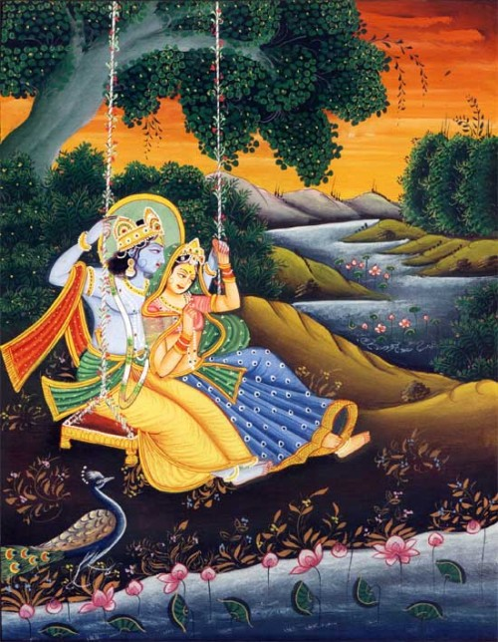
Jaya Rādha Mādhava
Jaya Kunja Vihārī
Jaya Gopī Jana Vallabha
Jaya Giri Vara Dhārī ... (Jaya)
Yaśodā Nandana Vraja Jana Ranjana
Yamunā tīra Vana Cāri ... (Jaya)
[ Hare Krishna Hare Krishna
Krishna Krishna Hare Hare
Hare Rāma Hare Rāma
Rāma Rāma Hare Hare ]

Slide 3
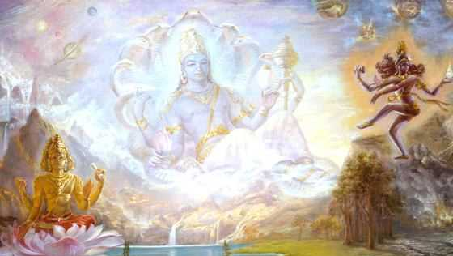
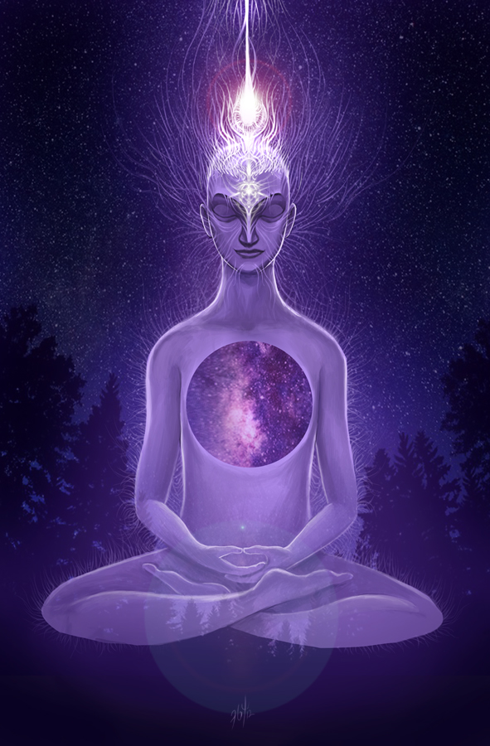
Spiritual World
PART-2
* All materials used in this are only for educational purpose.
Notes:
Hardly anyone know or realize our material worlds comprising of 14 levels arranged in 7 planes.
While, we can’t even know about our own world, how can we know about spiritual world?
What about Vedas?
Vedas cover mostly about the worlds until Brahma Loka. It is vague about higher worlds.
Also most of the religions cover until heaven and up to Brahma Loka only.
For example, some Christians believe that Israel is the final heaven and destination!
As per Padma Purana, we have 4 Sampradayas: Sri, Brahma, Rudra & Kumara. But these also don’t give full truth.
Each sampradaya has its own arena and realizations..
Each acharya coming after was giving higher truths from the previous acharyas.
Because there are differences in realizations, there are DIFFERENCES.
WHY?
Because there are differences in the Spiritual worlds as well.!!

Slide 4
Spiritual world is like 4 level compartments
Goloka Vrindavan (Madhurya)
Topmost
Madura (Vatsalya)
Dwaraka (Sakhiya)
Vaikunta (Dasya)
Bottom
RECAP
Notes:
RECAP:
In the previous episode, we saw that there are 4 major compartments in the spiritual world.
It is like four level compartment.
The ground floor is Vaikuntha
The 2nd floor is Dwaraka
3rd floor is Madura
Top floor is Gokola Vrindavan.
When Bhagavan Krishna came down, He brought a replica of those worlds to the earth.

Slide 5
Vaikunta (Dasya) – Highest Destination for all 4 paramparas
RECAP
Notes:
We also saw that:
All the 4 paramparas have VAIKUNTHA as the topmost goal..

Slide 6
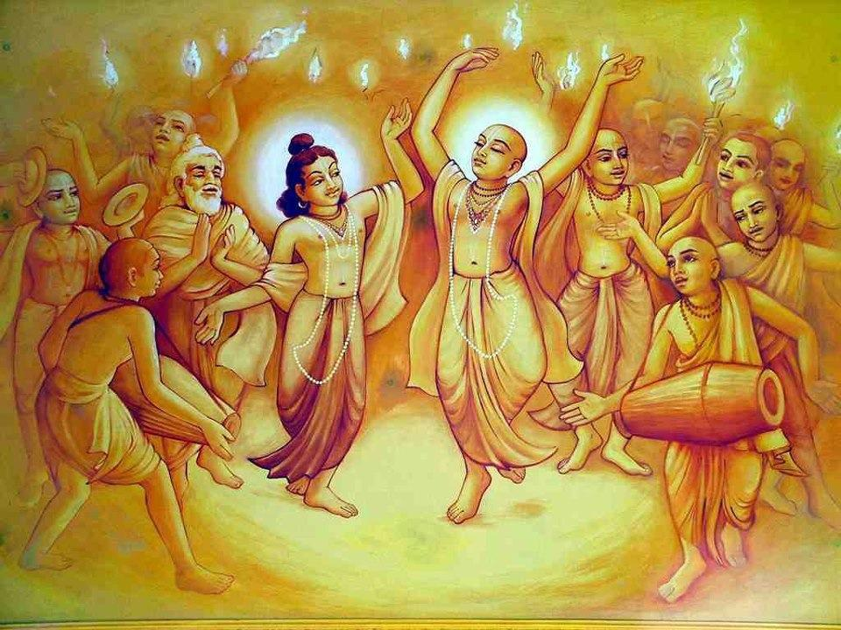
RECAP
Notes:
We also saw that Lord Caitanya gave us the knowledge to understand BEYOND VAIKUNTHA.
When a soul progresses thru VAIDHI Bhakti, then he can advance to RAAGA MARGA – by Grace.
Grace from Pure Bhaktas!

Slide 7
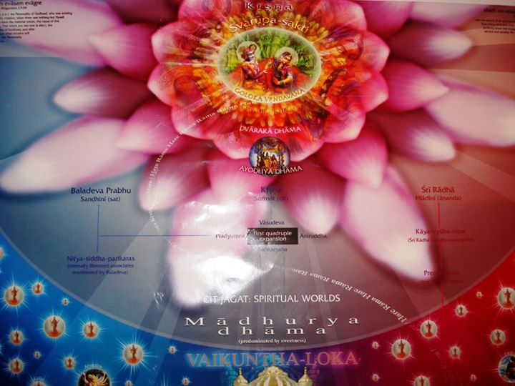
Goloka Vrindavan
Madura
Dwaraka
Vaikunta
RECAP
Notes:
In this Episode, we will see more characteristics of each of these levels.

Slide 8
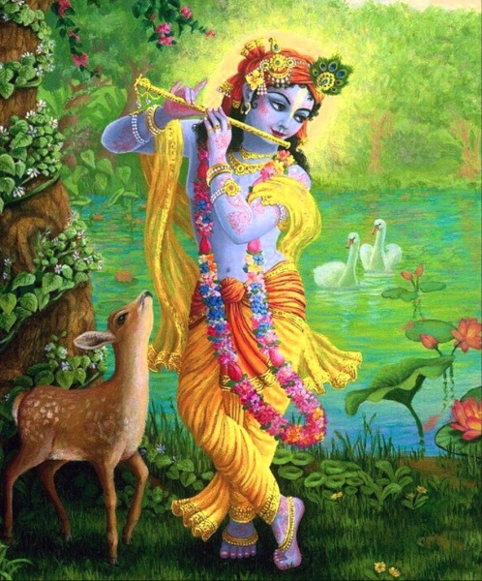
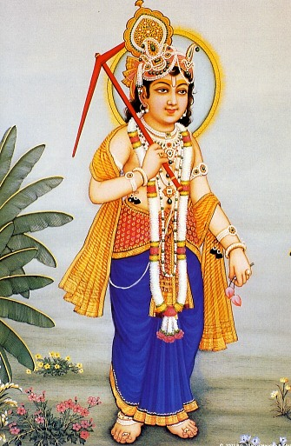
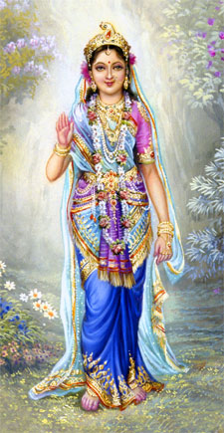
Primary Expansion
Svayam Bhagavan
Sri Krishna
Goloka Vrindavan
Balaram
Radha
RECAP
Swaupa
Sakti
Notes:
In the last class we covered this:
First, Sri Krishna expands into Balaram and Radha Rani.
This is the primary expansion.
All the associates who live in Goloka Vrindavan are their further expansions.
Balaram is the one who manifested Spiritual worlds.
The Jivatmas emanated by Balaram and the expansions of Radha Rani are the associates.

Slide 9
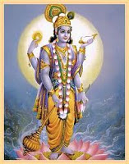
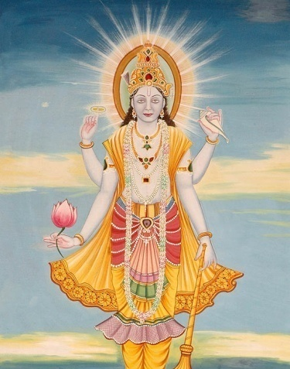
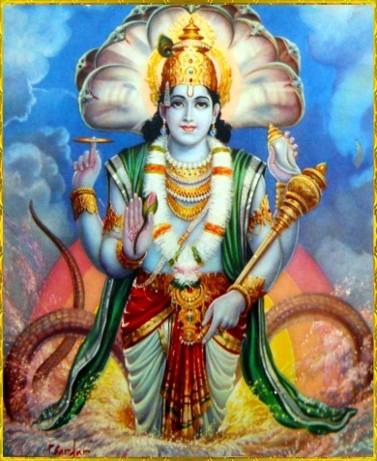
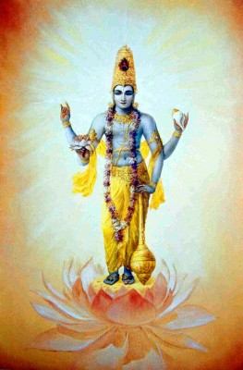
Ādi Catur Vyuha
(1st Quadruple Expansion)
Balaram
Madura & Dwaraka
RECAP
Vasudeva
Moola Sankarshan
Pradyumna
Anirudha
Notes:
Then all the further expansions come from Lord Bala Ram and Srimati Radha Rani..
This is called the 1st Quadruple expansion.
Balaram expands into Vasudeva, Moola Sankarshana, Pradyumna and Anirudha.
They all reside in Madura & Dwaraka.

Slide 10
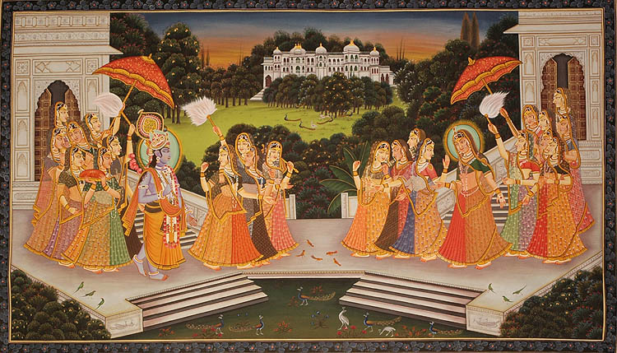
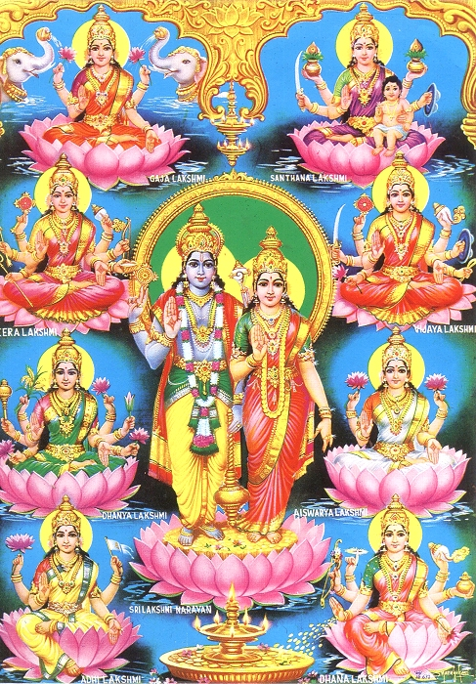
RECAP
Notes:
Similar to the expansions of Balaram,
In Madura & Dwaraka, Radha Rani expands and becomes Rukmini, Satyabhama and all the primary Queens.
Radha Rani also expands into Maha Lakshmi and Lakshmis in Vaikuntha.

Slide 11
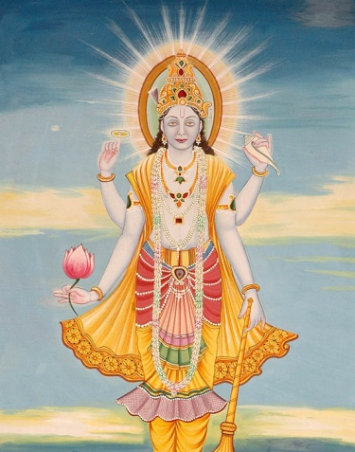
Dvitya Catur Vyuha
(2nd Quadruple Expansion)
Balaram
Like carbon copy of 1st
Vaikunta
Lord Narayana
Resides out of main Vaikunta
RECAP
Vasudeva
Maha Sankarshan
Pradyumna
Anirudha
Notes:
We also covered the 2nd Quardruple Expansion..
Lord Narayana rules Vaikuntha
Other 3 moves down and crosses Vraja River..
And takes the positions of maintaining the Brahmandas..

Slide 12
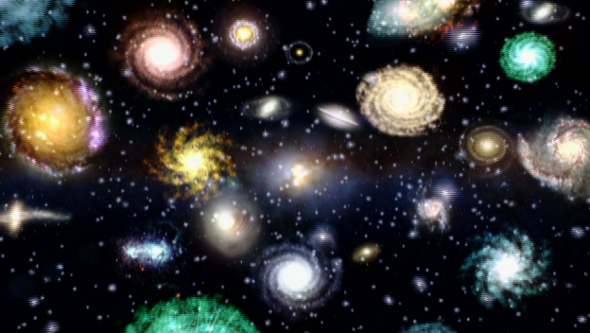
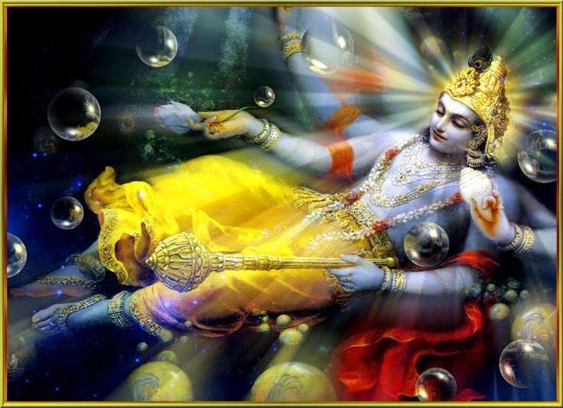
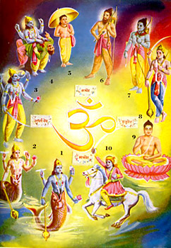
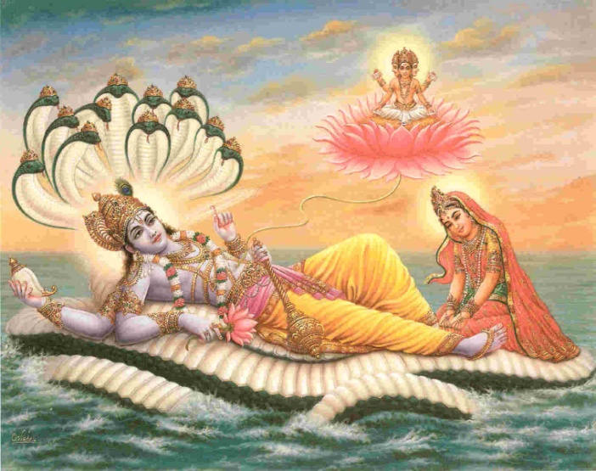
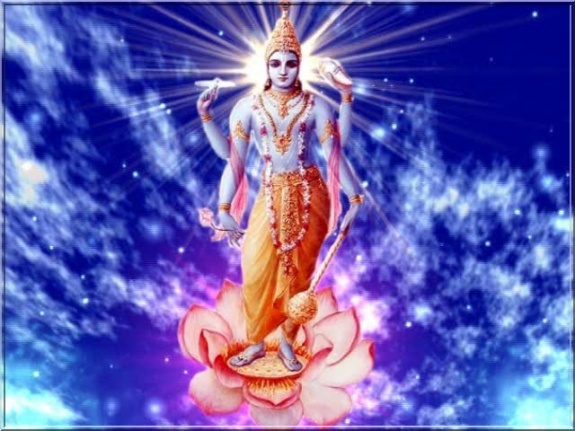
The 2nd Quadruple Expansion..
Kāranodakasāyi Vishnu
Vaikuntha
Vaikuntha
Vaikuntha
Garbhodakasāyi Vishnu
RECAP
Kshirodakasāyi Vishnu
Notes:
Kaaranodakasaayi Vishnu - Maha Vishnu (below Vraja River) who breaths out unlimited Brahmandas
Garbhodakasaayi Vishnu – Vishnu – one in each Brahmanda from whose navel Lord Brahma comes out.
Kshirodakasaayi Vishnu – Paramatma in every thing! He enters everywhere – every atom as well.

Slide 13
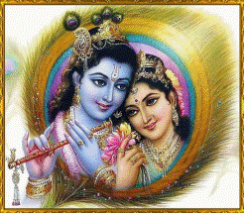
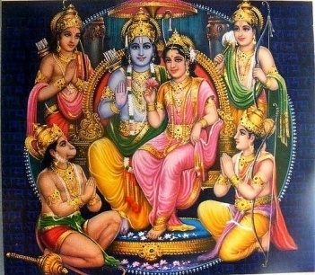
Who is original and Who is not?...
Goloka Vrindavan
Saketh
Madura/
Dwaraka
Vaikuntha
RECAP
Notes:
So, this is the whole picture of the Expansions of Lord Krishna.
Svayam Bhagavan is Sri Krishna.
All others are His expansions.

Slide 14
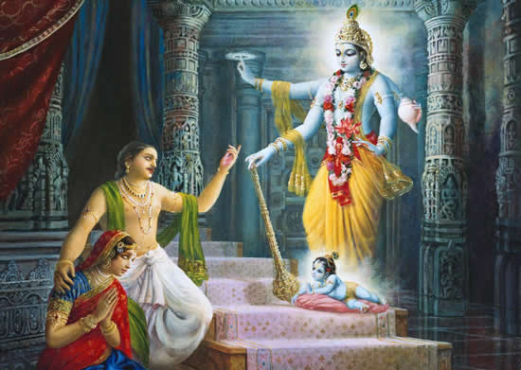
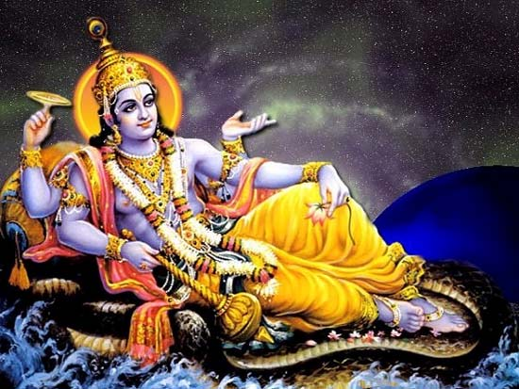
Yashoda Nandan
Goloka Vrindavan
Madura
Devaki Nandan
Dwaraka
Vaikuntha
No Nandan!
Notes:
Only the top 3 levels – Gokoka, Madura and Dwaraka - are the MAIN leela worlds.
Leelas from Vaikuntha are basic compared to the other 3.
In Goloka, we have Yashoda Nandan.
In Madura & also in Dwaraka we have Devaki Nandan.
Sriman Naraya does not take these kind of roles in Vaikuntha.
He is not any Nandan.

Slide 15
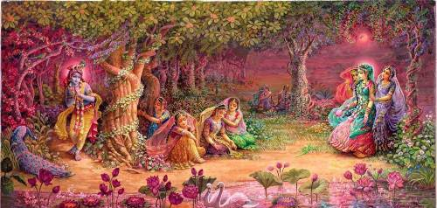
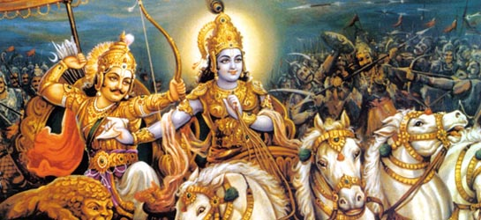
Yashoda Nandan
Devaki Nandan
Notes:
Now A Big Question:
Wh is Devaki Nandan & who is Yashoda Nandan? Are there any differences?
It was Devaki Nandan who delivered Bhagad Gita. He gave it to all. Krishna sang and Arjuna listned.
It was Yashoda Nandan who was with Gopis. Gopis taught Him – the Gopi Gita. Here Gopis sang and Krishna listened!
Devaki Nandan won’t use Flute.. He uses Shanku – Conch Shell. He won’t use peacock feather..
Yashoda Nandan won’t use Conch Shell.. He uses Flute and Peacock feather.
Devaki Nandan manages kings, people, etc – politician. He wears diamond helmet and very fine Silk.
Yashoda Nandan is cowherd and very simple!
So, they are very different..
This was the reason that not even a single Gopi visited Dwaraka – never.
Once there was one resident from vrindavan went to Dwaraka, and he was condemned by every one!
Yashoda Nandan never leaves Vrindavan.
Vrindavanam parityajya krishna
padam ekam na gacchet

Slide 16
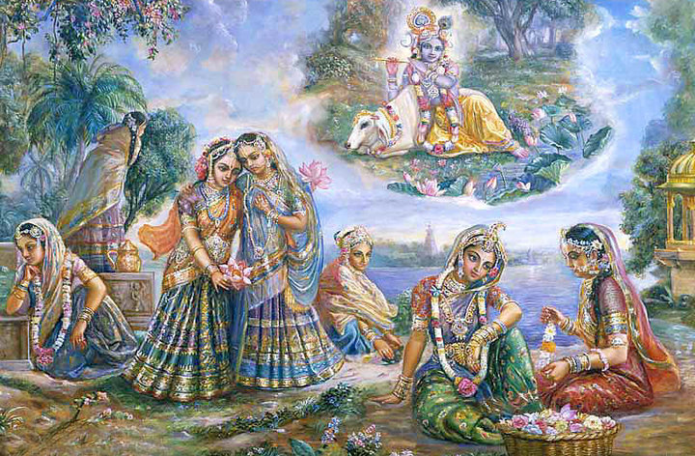
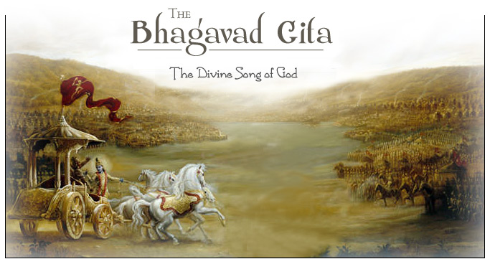
Yashoda Nandan
Gopi Gita by Gopis to Krishna!
Devaki Nandan
Sung by Krishna for others!
Notes:
Gaudiyas, the real followers of Lord Caitanya do not give much importance to Bhagavad Gita.
Why?
It is the dept of Devaki Nandan.
We take only 2 slokas from His Gita.
man-mana bhava mad-bhakto
mad-yaji mam namaskuru
mam evaishyasi yuktvaivam
atmanam mat-parayanah (B.G. 9.34)
[ Lord Krishna says, always think of me, become my devotee offer obeisances to me and worship me then surely you will come to me. ]
2) Sarva-dharman parityajya
Mam ekam saranam vraja
Aham tvam sarva papebhyo
Moksayisyami ma sucah (B.G. 18.66)
Some Gaudiyas do give importance to Gita. Srila Prabhupada came to give the highest, but had to cut lot of jungle
And Bhagavad Gita was necessary for them..

Slide 17
Devaki Nandana
Yashoda Nandana
Majastic, Diamond, Shanku
Cowherd, Peacock, Flute
Gita, Killing Daemon
Gopi Gopa Leela
Most Opulent
Simple
Fearful
Controlled by Love
Reverence & Respect
Sweet & Intimate
Belongs to Vidhi Marga
Belongs to Raga Marga
Notes:
But, a question:
Can one jump straight to Raaga Marga?
Answer is: NO!
Without following Vidhi Marga, one cannot got to Raaga Marga.
So, Vidhi Marga is a step towards Raaga Marga.
Every jiva will come thru Vidhi Marga.

Slide 18
Fear of God vs Love of God
Most of the religions teach: Fear of God
Eg: Christianity, Islam, Hindus.. Most religions
This is rude
Instead, we should teach to love God
We are not criminals.!
We are His own dear children!
Notes:
Any religion that preaches LOVE of God WITHOUT fear is the Highest..
Our goal must be to get PREMA on God..
When a child does what the mother does not want, she used to threaten like:
“If you do this, Ummachi (God) will pierce your eyes!”
This is making oneself ‘Bhaya Bhakti’.
Every religion has this tendency as they are basic.

Slide 19
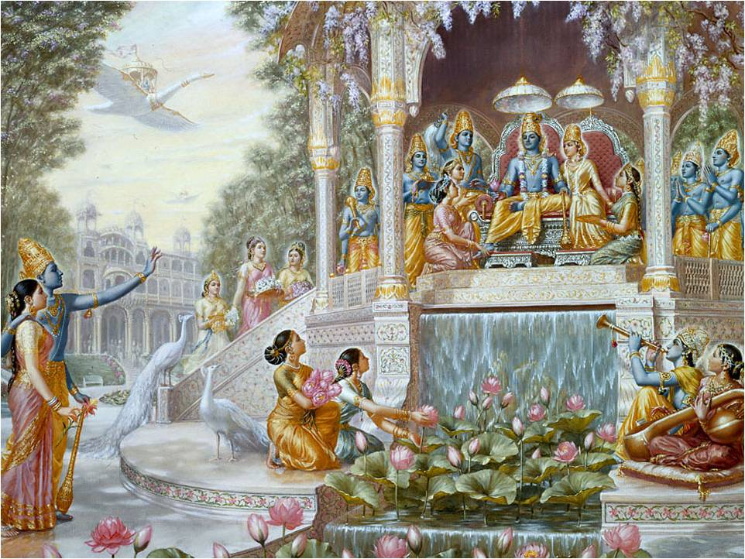
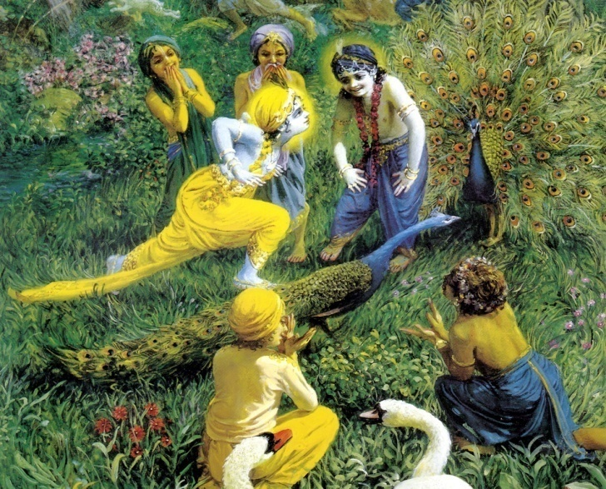
Vaikuntha
Vrindavan
Discipline! Strict Discipline!!
Laxmi, all serving
Predominant: Dāsa Bhava
Some Fear of God
Freedom
Dancing
Singing
No Rules!
Fullest Bliss! Ever Increasing!
Notes:
If we Compare Vaikuntha and Vrindavan, it can be like this:
Western Countries and India
Full Rule versus NO Rules!
Western: Marriage: Cream color suit, Office: Tie and Suit, Death: Black color suit
Western: Traffic: Can’t cross just like that, no horn, no spitting anywhere
India: Cows, Dogs, Pigs all on road.. Horn all the times
Freedom needs no discipline!
Brhad Bhagavatamrta mentions a case of Gopa Kumara and ‘Going Beyond Vaikuntha’

Slide 20
Relative Bliss in Spiritual World
Brahman
Tiny drop of Ananda
Vaikunta
Cups of Ananda
Dwaraka
Drums of Ananda
Madura
Lake of Ananda
Gokola
Unlimited Ocean of Ananda
Svetadwip
Unlimited Ocean of Ananda
Notes:
Now, let us explore the relative happiness in different spiritual worlds.
Jnanis and Santa Bhava Bhakta may reach Brahma Jyoti – the Brahman.
It has nly a tiny drop of happiness.
Who wants just a tiny drop of Happiness?
We want oceans of Happiness!!

Slide 21
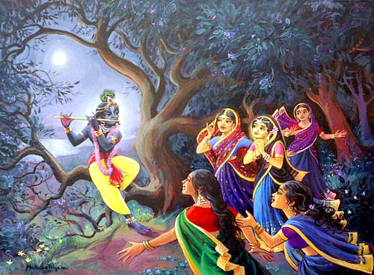
Which Nandana do you like?
Yashoda Nandana?
Devaki Nandana?
OR
Notes:
So, our choice is clearly for Yashoda Krishna!

Slide 22
What is required to reach Yashoda Nandan Krishna?
Can we get Him by:
Ashtanga Yoga?
Meditation?
Karma Yoga?
Jnana Yoga?
Bhakti Yoga as per Gita?
What do you need?
And what about reaching Vaikuntha?
Notes:
Where will the bhakti mentioned in Gita will take you?
Vaikuntha..
Not to Goloka..

Slide 23
OV-37
On the fly sloka)
Karma Kānda Jnāna Kānda
Kevala Vişera Bhānda
Amrta Baliyā Yerā Khāya
.. Narottama dasa Thakura
“Karma, the fruitive activities and Jnana the speculative knowledge are as POISONS for they lead us away from Pure Bhakti..”
To get Pure Bhakti
Notes:
Karma and Jnana can NEVER take us to Goloka!
In fact, they are POSIONS!
They will kill pure bhakti..

Slide 24
Four Main Rasas (of twelve)
Sānta Rasa
Dāsya Rasa
Sakhya Rasa
Vatsalya Rasa
Mādhurya Rasa
Notes:
Now, we will explore more into the primary rasas..
What are they?
Santa Rasa – Bhava of neutral
Dasya Rasa – The bhava of servitude.
Sakhya Rada – The bhava of friendship. Dasya Bhava is also included.
Vatsalya – the bhava od Parental relation. All the 2 above bhavas are also included.
Madhurya – the bhava of conjugal love. All the above bhavas are also included.

Slide 25
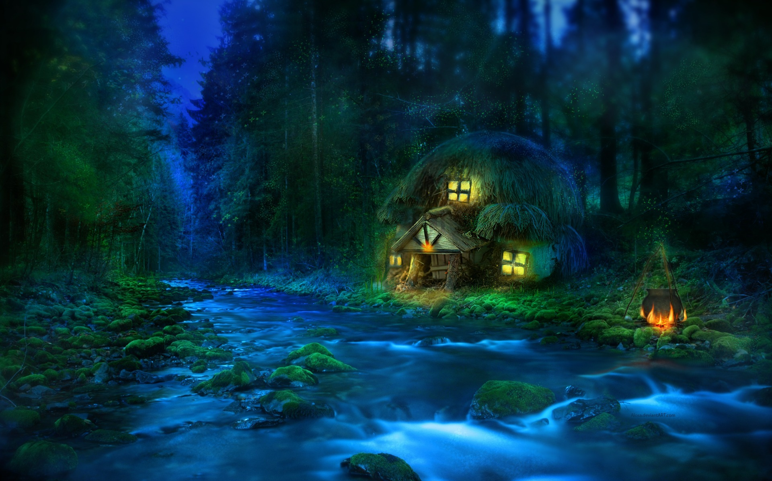
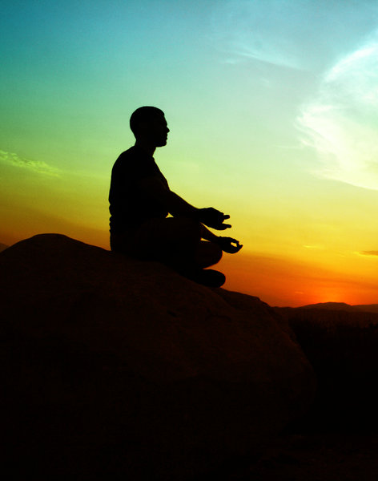
Sānta Rasa
Notes:
What is the unique charasteristic?
Peaceful..
Self satisfied and alone..
Self Enjoying… Meditation..
No service to Lord at all.

Slide 26
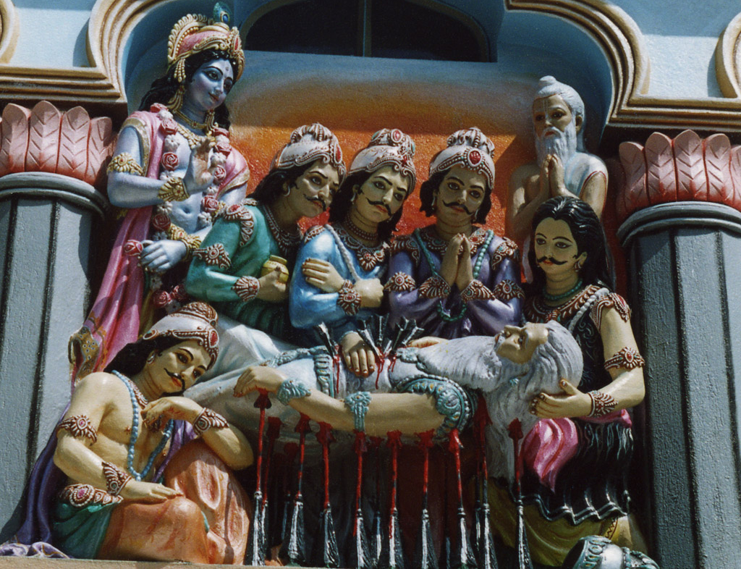
Sānta Rasa
Bhishma Dev
Prahlad
Maharaj
….
Notes:
What is Saanta Rasa?
This is a preliminary stage..
“Yes God is great!”
“He protects me!”
“He is very powerful!”
But a Santa Rasa bhakta will never serve the Lord!
But he has full FAITH!
Example: Bhishma Deva, Bhakta Prahlada and so on..

Slide 27
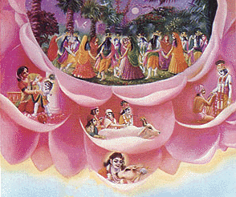
Madhurya
Dasya
Valtsalya
Sakhya
Notes:
Santa Bhava – Neutral..
Dasya Bhava – Obedient to Bhagavan. Jiva serves Bhagavan mostly in Bhaya Bhakti.
Sakhya Bhava – two way service. Lord and Jiva are equal level.
Vatsalya Bhava – Bhagavan is obedient to the Bhakta. Bhakta orders, not bhagavan. Nanda Baba asks Krishna to bring chapel – not other way.
Madhurya Bhava – Bhakta plays all above and in conjugal love. This is the highest.
Now, I am going to divide each of them into two categories.

Slide 28
Rasas - Gaurava & Visrambha - Examples
Gaurava
Visramba
Dasya
Hanuman
Ratrak, Patrak,..
Sakhya
Arjuna
Subala
Vatsalya
Devaki
Yashoda
Madhurya
Rukmini
Gopis
Notes:
All the four primary rasas can be dived into two categories.
Gaurava and Visrambha.
What is Gaurava? It means Majestic, Reverence.
What is Visrambha? It means Intimate, Simple.

Slide 29
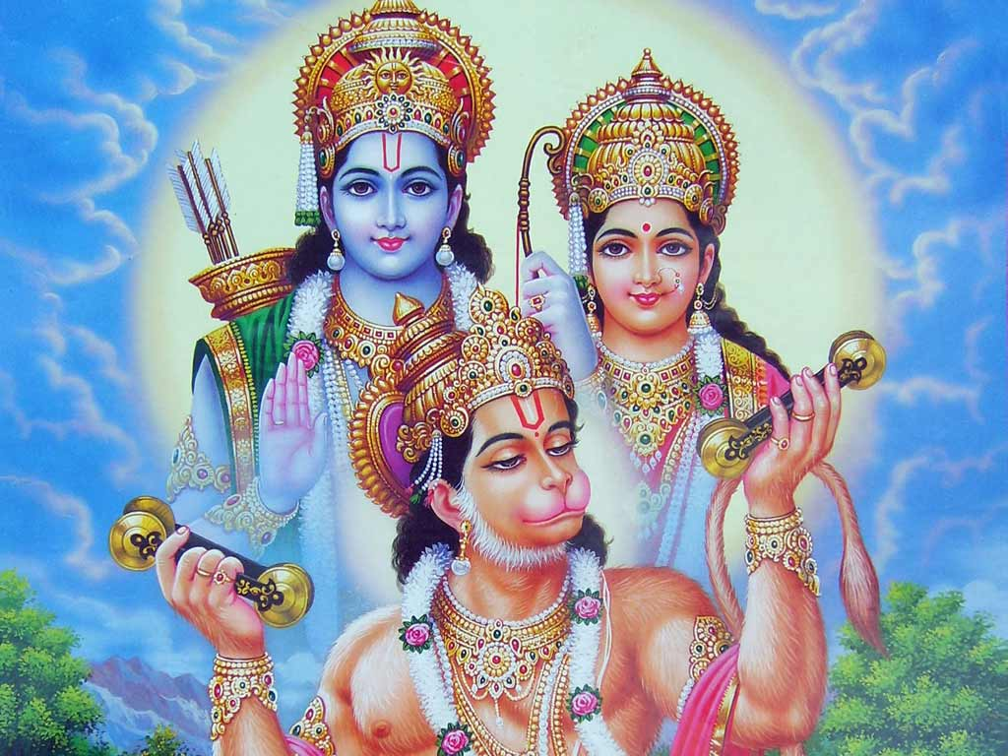
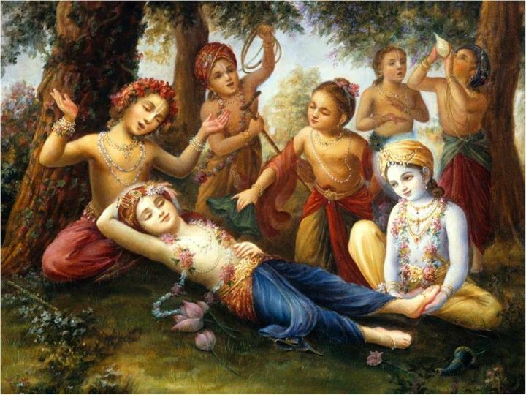
2. Dāsya Rasa
Gaurava Dāsya
Visrambha Dāsya
Notes:
Story:
Hanuman: Eating only after Rama, RESPECT..
Vrindavan: Patrak, Ratrak.. Intimacy..

Slide 30
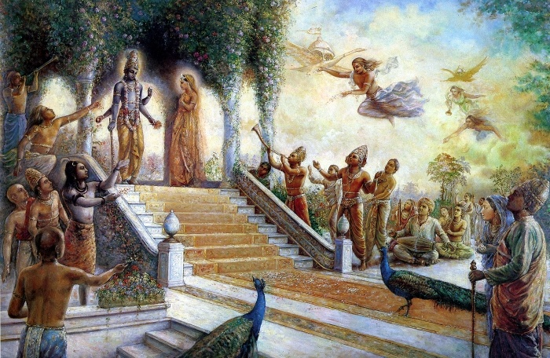
Gaurava Dāsya
Notes:
Vaikuntha is the classical example of Gaurava Dasya Rasa

Slide 31
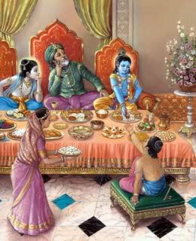
Visrambha Dāsya

Slide 32
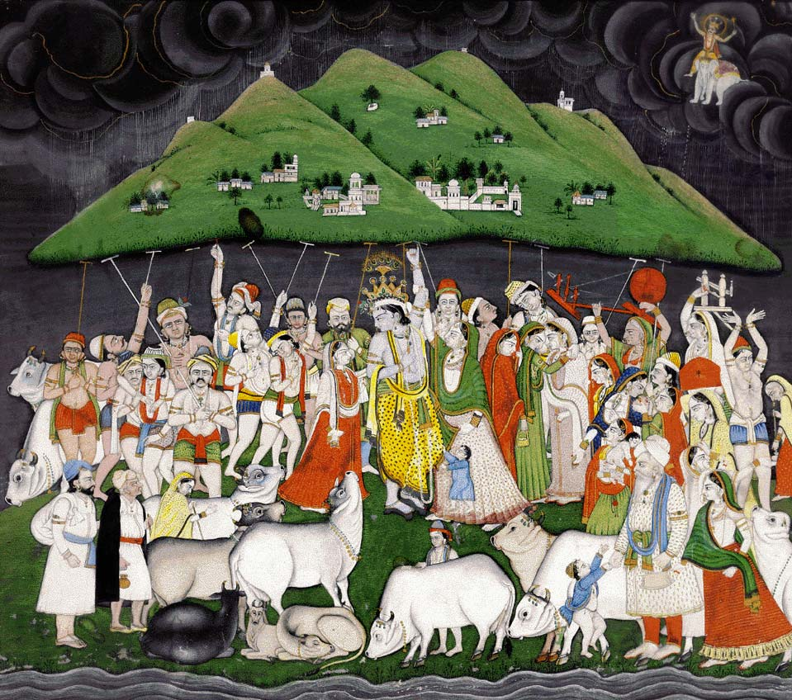
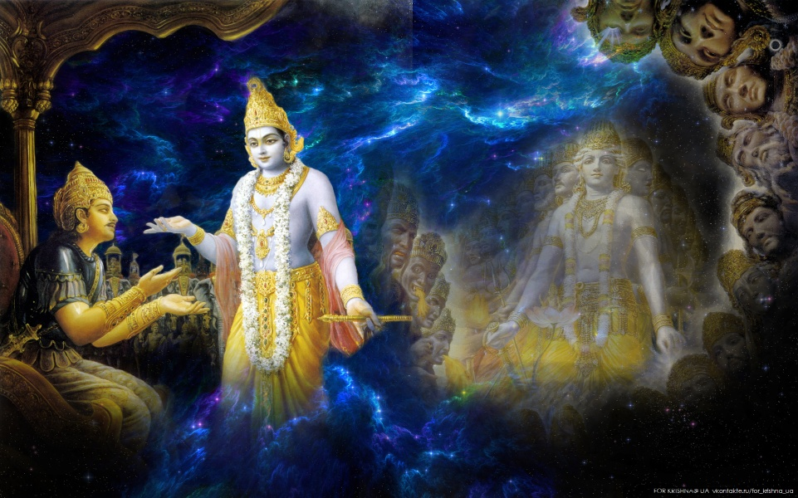
3. Sākhya Rasa
Gaurava Sākhya
Visrambha Sākhya
Notes:
Story:
Arjuna: Feared when Krishna showed Visva Rupa.. Trace of Fear was there.
Gopas: Claimed that they actually lifted Govardan
When playing, asked Krishna to carry them when Krishna failed.
They are very intimate!

Slide 33
Gaurava Sākhya

Slide 34
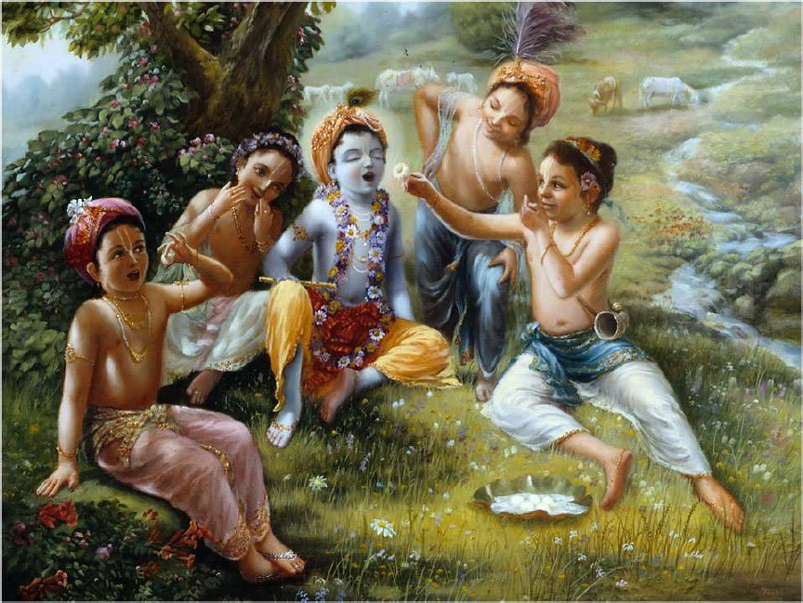
Visrambha Sākhya

Slide 35
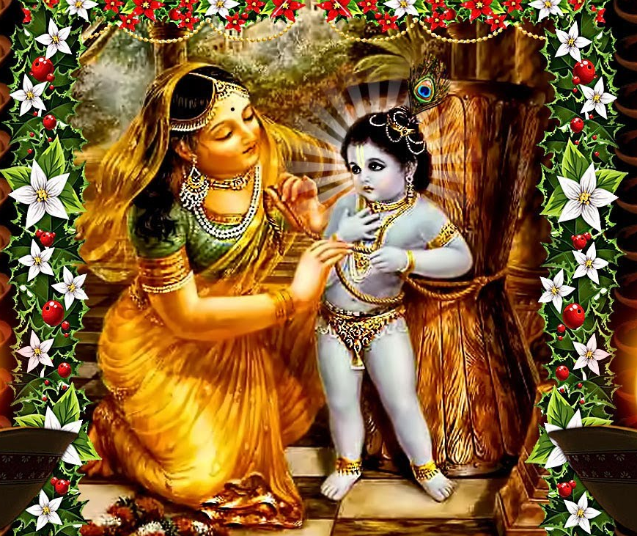
4. Vatsalya
Gaurava Vatsalya
Visrambha Vatsalya
Notes:
In north India, those from Vallabhacharya used to carry Ladu Gopal ..
Wherever they go, they carry him. Train, bus, wherever.
Before they eat, they always feed him as their own son.. – PUSHTI MARGA! This is a kind of vatsalya.
Madura: When Krishna, her own son came after 11 years, what will a mother do?
She must have kissed Him, and cried..!
But instead, she stayed and prayed to Him..
Vrindavan: But in Goloka, Yashoda will punish Krishna if he is naughty!
Who can tie Krishna in a grinding mortar!
There is no trace of fear of Krishna
She never considered that Krishna, the supreme lord was her child.
This is the difference between gaurava vatsalya and Visrambha vatsalya!
Yashoda wanted the Love.. Devaki wanted just Krishna as son.

Slide 36
Gaurava Vatsalya

Slide 37
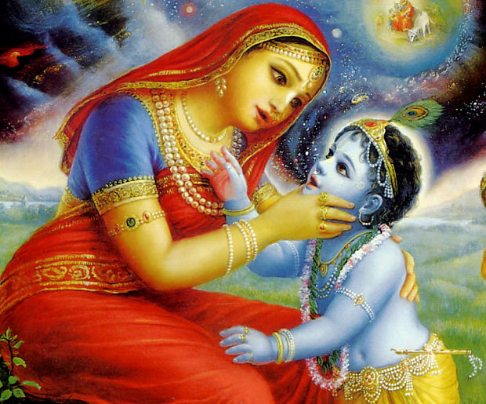
Visrambha Vatsalya

Slide 38
For Yashoda, Krishna is an Ordinary Child!
trayyā copanişadbhiś ca
sānkhya-yogaiś ca sātvataih
upagīyamāna-māhātmyam
harim sāmanyatātmajam … S.B. 10.8.45
“The glories of the Supreme Personality of Godhead are studied through the three Vedas, the Upaniṣads, the literature of Sāṅkhya-yoga, and other Vaiṣṇava literature, yet mother Yaśodā considered that Supreme Person her ordinary child.”
Notes:
So, Krishna gave exactly where they positioned!
Devaki could not get the Childhood pastime for 11 years!
All went to Yashoda..!
So, we should be careful what we are asking for!

Slide 39
D-48.1
Yaśomatī-nandana, vraja-vara-nāgara,
Gokula-rañjana kāna
Gopī-parāṇa-dhana, madana-manohara,
Kāliya-damana-vidhāna ......... (Yaśomatī)
Amala harināma amiya-vilāsā
Vipina-purandara, navīna nāgara-vara
Vaḿśī-vadana suvāsā ......... (Yaśomatī)
Vraja-jana-pālana, asura-kula-nāśana
Nanda-godhana-rākhowālā
Govinda mādhava, navanīta-taskara,
Sundara nanda-gopālā ......... (Yaśomatī)
39
Notes:
39

Slide 40
D-48.2
Yaśomatī-nandana, vraja-vara-nāgara,
Gokula-rañjana kāna
Gopī-parāṇa-dhana, madana-manohara,
Kāliya-damana-vidhāna ......... (Yaśomatī)
Yāmuna-taţa-cara, gopī-vasana-hara,
Rāsa-rasika, kṛpāmaya
Śrī-Rādhā-vallabha, vṛndāvana-naţavara,
Bhakativinoda-āśraya ......... (Yaśomatī)
40
Notes:
40

Slide 41
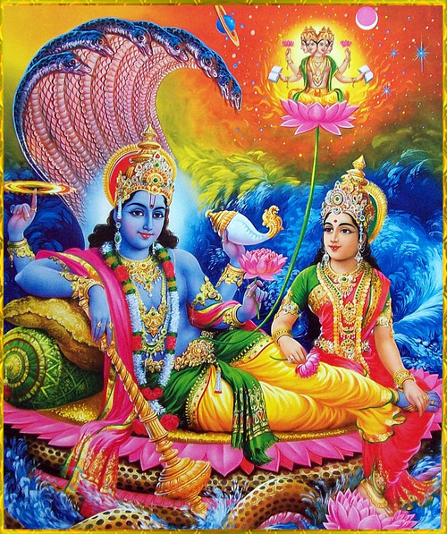
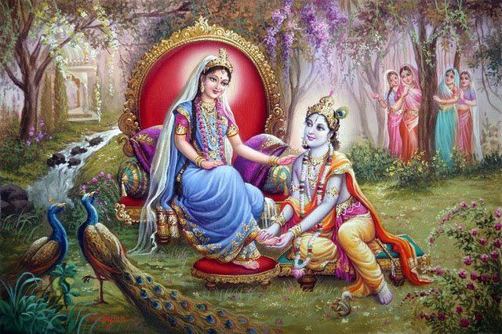
5. Madhurya
Gaurava Madhurya
Visrambha Madhurya
Notes:
Dwaraka: Rukmini, Lakshmis (Vaikuntha) - all belong to Gaurava Madhurya
They want to be MARRIED (Svakiya)
They want protection from Lord
They also serve in great RESPECT.
They follow strict Dharma.
Vrindavan: But in Vrindavan it is opposite.
They have UNMARRIED relation (Parakiya)
No Dharma, No karma, no Jnana – nothing.
The only thing they have UNCONDITIONAL PREMA!

Slide 42
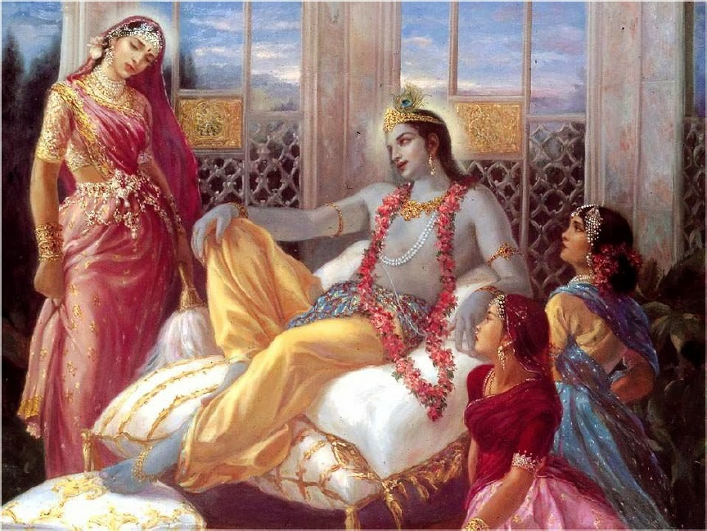
Gaurava Madhurya
Notes:
Story:
Dwaraka: Rukmini was teased by Krishna, and Rukmini fainted.
Vrindavan: Krishna went to see a Gopi, and the Gopi rejected and scolded..
Krishna had to disguise as a gopi to meet that Gopi.
Prem Samputa and many rasika scripts from Goswamis reveal so many things in this.

Slide 43
Visrambha Madhurya

Slide 44
Madhurya also has Dasya

Slide 45
Madhurya also has Sakhya

Slide 46
Madhurya also has Vatsalya

Slide 47
Madhurya – Union & Separation

Slide 48
Which one did Maha Prabhu bring ?

Slide 49
How difficult is to get to the Spiritual Worlds?
Brahman – Easy (Jnani and Yogi)
Vaikuntha – Difficult (Dasya)
Dwaraka – More Difficult (Sakhya)
Madura – Very difficult (Sakhya)
Goloka – Almost Impossible!
Notes:
Different levels in Spiritual world gives different levels of Ananda..
And all the Rasas are here in this material world too..
But they are perverted reflection of the spiritual world..
Once, one gets the taste of the spiritual world, these tastes becomes nothing!
But, how will you know and start the taste of Spiritual world?
Especially the topmost Goloka Vrindavan?
There is only one way! There is no other way!

Slide 50
How can we get to Goloka?
ONLY by the mercy of Sadhus – Pure Devotees of Krishna!
sādhu-sanga sādhu-sanga
sarva-śāstre kaya
lava-mātra sādhu-sange
sarva-siddhi haya …. (CC Madhya 22.54)
“Simply by associating with a pure devotee, one becomes wonderfully advanced in Kṛṣṇa consciousness and obtain complete spiritual perfection!.”
Notes:
There is no other way!
Only by associating with those who have come from that world, or seen that world, it can be obtained..!
With that association, one practices the 9 angas of bhakti..
What are they?

Slide 51
Nine angas of Bhakti
Sravanam kirtanam visnoh
Smaranam pada-sevanam
Arcanam vandanam dasyam
Sakhyam atma-nivedanam ..... (S.B. 7.5.23)
[The nine processes of bhakti are: Hearing, chanting, remembering, serving His lotus feet, worshiping, offering prayers, being a servant, being dear, and offer ones soul to the Lord. ]
Notes:
This is the process..
What is Sravanam?
Hearing! Hearing what?
Hearing the Names, Qualities, Glories, and Pastimes of Krishna! This is Hari Katha.
Then comes Kirtanam and Smaranam and so on.
Eventually one will go thru Dasyam, then Sakhyam and other higher stages depending upon one’s nature – our svarupa.

Slide 52
Lord Caitanya is the Yuga Avatara for kali Yuga inaugurating the Nama Sankirtan!
He is Prema Purushottama
(Lord Rama is Maryada Purushottama)
Notes:
Lord Caitanya maha Prabhu came to this world about 500 years ago.
He as the Yuga Avatar of Kali Yuga, inaugurated the Nama Sankirtan movement – Chanting and singing the holy names of Krishna!
He is Prema Purushottama!
He is the only one who can give Prema for Krishna.
By chanting the maha mantra, we can achieve perfection and Prema to Krishna!
We are so lucky that we are born near to His time of pastime.
We pray Lord Gauranga for His causeless mercy..
So that we get Prema for Krishna!

Slide 53
E-98
O Gaurangaa! O Krishnaa Gaurangaa
Sri Caitanyaa Gaurangaa .... (O Gauranga)
Sarva Raksha Devane, Saci Suta Baalane
Svarna Deha Rupane, Simha Raaja Garjane .... (O Gauranga)
Theena Da Yaalane, Taara Mantra Devane
Deva Deva Devarum, Pottum Para Moolame .... (O Gauranga)
Nama San Keertanam, Nagara Nal Naatiyam
Vaana Mazhai Pol Kangal, Pongum Thiru Kolame .... (O Gauranga)
Raja Su Sundaraa , Ramya Rupa Shobanaa
Radhaa Krishnaa Samgata, Prema Dhaana Devataa .... (O Gauranga)

Slide 54
Spiritual World
PART-2

